Slide 1
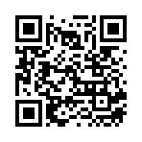
HL ONLY
TOPIC A4:
MACHINE LEARNING
LESSON A4-3
DATA CLEANING
FILL OUT QR CODE
OR ELSE

Slide 2
AGENDA
Warm up
The class data set
Why data quality matters
Missing data
Outliers
Duplicates and incorrect data
Irrelevant and bad formatting
Normalization
Standardization
How was our data?
Lab
Close
WHAT U NEED 4 LESSON
Guided Notes
ur hedz

Slide 3
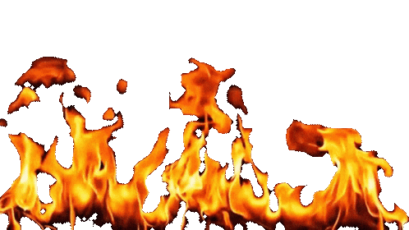
THE WARM UP QUESTION
(a) State one difference between training and inference [1]
(b) State one reason a GPU is well suited to training a model [1]
(c) State one advantage of running a model on an edge device [1]
→ Notes Q1 (a), (b), (c)

Slide 4
THE WARM UP ANSWER
(a) Training builds the model and happens once, taking hours or longer; inference uses the finished model and happens quickly, in milliseconds
(b) It has thousands of simple cores doing the same operation at once, which is how training occurs
(c) No network round trip, the data never leaves the device, and it still works offline

Slide 5
THE CLASS DATA SET
Thank you everyone for filling out my survey
Let’s look at the data to see how it turned out!
Can anybody identify any potential issues with the data?

Slide 6
THE CLASS DATA SET
Which column looks the most reliable? Which looks the least?

Slide 7

WHY DATA QUALITY MATTERS
Labelled data is scarce
  Even worse – a lot of the time collected data is borked
Real data can have many issues, such as forms filled in badly, sensors that cut out, and separate databases merged decades ago
  A model can’t understand any of this, any typo becomes a fact
If even just 5% of your labels are wrong, the model learns those too, no matter how good your processing power is
Data cleaning is what we call ‘preparing’ data before it is used for training
On lots of real projects, this is the part that takes the longest

Slide 8
WHY DATA QUALITY MATTERS
Here are six specific potential problems that you can run into with
→ Notes Q2 (a) and (b)
The problem | What it looks like
Missing data | A blank where a value should be
Outliers | A value far outside the rest
Duplicate data | The same record entered twice
Incorrect data | A value that is simply wrong
Irrelevant data | A column that cannot help
Bad formatting | The right value written the wrong way

Slide 9
MISSING DATA
Missing data can occur when you have: a blank cell, somebody skips a question, or a sensor glitched out
  Maybe a database was modified to add a new field
Most algorithms cannot handle any missing data and will crash
Three potential solutions:
Deletion – delete the whole row
Imputation – fill the gap with an inferred value, usually the average value of that column
Predictive modelling – use other columns to predict the missing value, looking at similar columns

Slide 10
MISSING DATA
Imputing the mean: let’s say a column reads 10, 20, 30, ?, 40
The mean of what is there is 25, so the blank becomes 25
The column mean remains the same as it was before, not messing much with the data
  But, in doing this, you have invented a new, fake data point
  The spread of the column is smaller, increasing the confidence of the model
→ Our sheet: find a blank. Whose row is it, which column, and what would you put there?
→ Notes Q3 (a), (b) and (c)

Slide 11
MISSING DATA
You will have to decide in which case to do each of these based on context
Method | Use it when | The cost
Deletion | Few rows affected, plenty of data left | Fully losing that row of data
Imputation | A few gaps in an otherwise good column | Not real values, shrink spread
Predictive modelling | The other column data is used to predict it | Takes more time, can be wrong

Slide 12
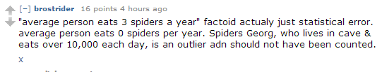
OUTLIERS
An outlier is a value that sits far away from the rest of the column’s values
  Like an age column of teenagers with one entry reading 900.
Just because a value is an outlier doesn’t always mean it’s false though!
  Age of 900 is an error, but £4 million in a payroll file might be the chief executive, and you’d get fired if you delete it
Your choice: remove it, cap it, or keep it
Notes:
The judgement is always the same question: is this value impossible, or just unusual?

Slide 13
OUTLIERS
Whichever you pick, you should probably document it irl fwiw.
→ Notes Q4 (a) and (b)

Slide 14
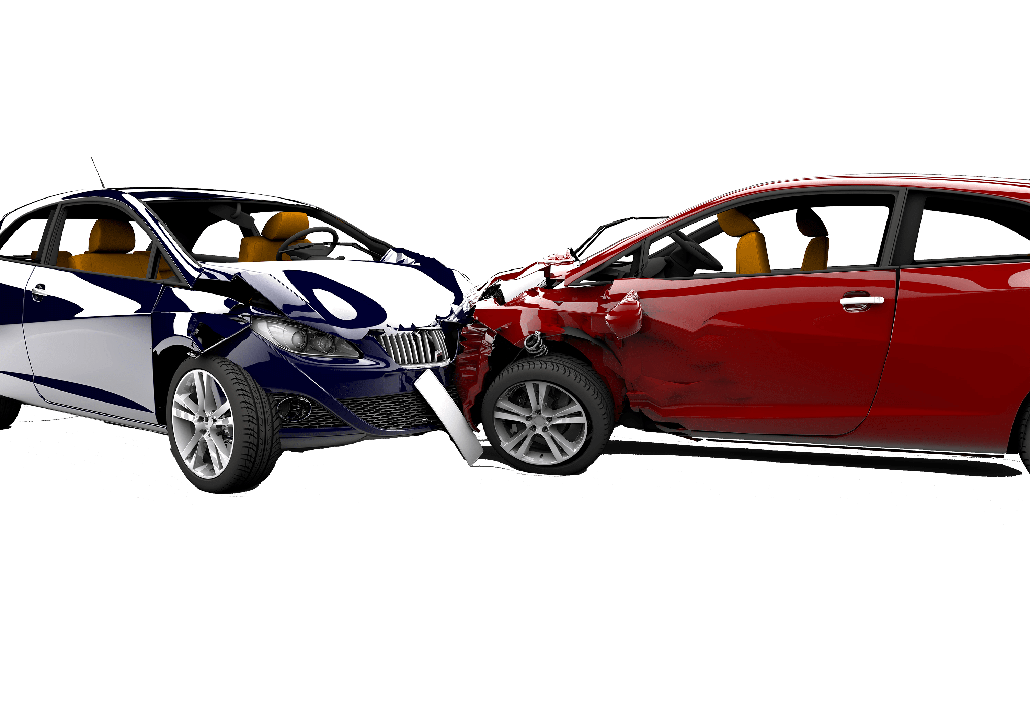
DUPLICATES AND INCORRECT DATA
Duplicate data is correct data appearing multiple times
  Usually because two systems got merged
If you leave both in, the trained model will weight it double (bad)
Either remove the extra copy, or consolidate them if each holds unique information

Slide 15
DUPLICATES AND INCORRECT DATA
Incorrect data is a value that is provably wrong
  A height of 1.75 among a row of 175
    This is a unit problem, easiest to avoid when initially collecting data
→ Notes Q5 (a) and (b)

Slide 16

IRRELEVANT AND BAD FORMATTING
Irrelevant data is a column that cannot possibly help the prediction
This is a different kind of discussion, more about what we include in our model
Example: student ID shouldn’t have any correlation to GPA
  Including it in our model would lead to noise that it just doesn’t need

Slide 17
IRRELEVANT AND BAD FORMATTING
Badly formatted data is a correct value, just written the wrong way
Three different date formats in one column
“Yes”, “yes”, “Y” and “TRUE” all meaning True
12/01/2026 can mean January or December based on who typed it
→ Notes Q6 (a) and (b)

Slide 18
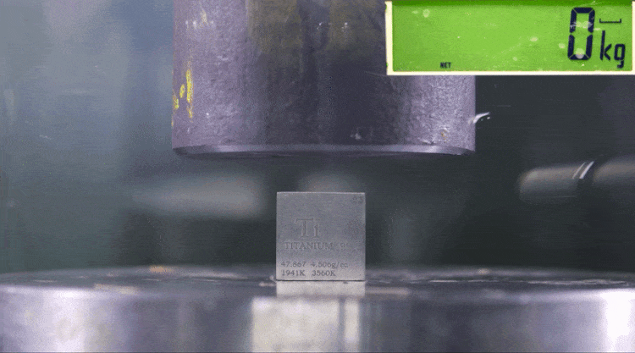
NORMALIZATION
Just because we don’t have any abject errors doesn’t mean that the data is ready just yet!
Normalization squeezes every value in a column into the range 0 to 1
  yes, this is the same word used in the database topic
    no, it is not the same thing
      yes, it’s annoying
Subtract the smallest value in the column, then divide by the range
The smallest value always becomes 0 and the largest always becomes 1 regardless of what the units were

Slide 19
NORMALIZATION
Again, it doesn’t matter how different the values are, they all get put on the same scale
Original value | Column A (10 to 50) | Column B (20000 to 60000)
Smallest | 10 → 0 | 20000 → 0
Next | 20 → 0.25 | 30000 → 0.25
Next | 30 → 0.5 | 40000 → 0.5
Largest | 50 → 1 | 60000 → 1

Slide 20
NORMALIZATION
Let’s calculate ‘distance’ between two data points using k-NN
Let’s say person 1 is 25 earning 30,000 and person 2 is 45 earning 31,000
Distance formula: √(x2-x1) + (y2 – y1)
  In this instance, x is age and y is salary
    √(45-25) + (31000 – 30000)

Slide 21
NORMALIZATION
√(20² + 1000²) = 1000.2
Looking at this, salary is almost all of that distance, the age difference in our data has become insignificant
If you normalize both columns and 1 becomes (0.1, 0.1) while 2 becomes (0.5, 0.11)
  Assuming the min age is ~20, the max age is ~70, and the min salary is ~0 and the maximum is ~1,000,000
New distance: √(0.4² + 0.01²) = 0.4001, and now age makes up a much larger chunk of the distance
  Nothing about the two people changed, just the way we measured them
→ Notes Q7 (a) and (b)

Slide 22
STANDARDIZATION
Standardization is the other way of making columns comparable
Subtract the mean of the column, then divide by the standard deviation
The result is a z-score: how many standard deviations this value sits away from the average
A column standardized this way has a mean of 0 and a spread of 1
This is better with outliers, because outliers compress the data a bunch when you consider them

Slide 23
STANDARDIZATION
Here is a column with a mean of 5 and standard deviation is 2
A value of 9 becomes 2: two standard deviations above average
→ Notes Q8 (a), (b) and (c)
Value | 2 | 4 | 5 | 9
z-score | −1.5 | −0.5 | 0 | 2

Slide 24
WHY OUR DATA WAS BAD
So why was our initial data such a mess?
  It’s not because any of you are careless, it’s because I was (intentionally) lazy
Free text boxes, no units, nothing marked as required, no list to choose from, no check on anything
→ Our sheet: pick any one of the six problems we found. What single change to the form would have stopped it?
Almost every problem with data is simpler to prevent in the first place than to clean up after the fact

Slide 25
LAB
→ Notes Q9 and Q10 — silent, five minutes
Q9 A table of patient records is shown. Identify two separate data quality problems in it and state how you would deal with each [2]
Q10 Explain why normalization matters for an algorithm that measures the distance between examples [2]
Notes:
Q8 is the one that will appear on the exam. Make them name the problem using the syllabus word.

Slide 26

VOCABULARY TO REMEMBER
Data cleaning
Data quality
Missing data
Deletion
Imputation
Predictive modelling
Outlier
Capping
Duplicate data
Consolidation
Incorrect data
Irrelevant data
Formatting
Normalization
Standardization
Standard deviation
z-score

